Slide 1
TweetPath - A Multi-Objective Evolutionary Approach to Touristic Route Planning
Rajan Dosanjh
MSc Computer Science
14th August 2025
Notes:
Put numbers in slide

Slide 2
Background
Tourists in large cities face immense choice in planning efficient and interesting travel routes. Most route planners tend to focus on minimising time, with few integrating POI and transport booking services (Pugacs et al 2017).
As social media becomes a popular source of travel inspiration, travel applications and route planners need to integrate user-generated content (Hays et al 2013).
Notes:
Add more references

Slide 3
Project Objectives
To develop a web application that generates near-optimal tourist routes in London, to minimise travel distance and maximise user satisfaction.
  Distance = defined as the Euclidean distance between each location
  Satisfaction = average of a location matching the selected route category and the sentiment of tweets linked to it
To use a Multi-Objective Evolutionary Algorithm (NSGA-II) to balance the two goals.
To leverage (simulated) Twitter/X data to provide recommendations to help users decide on locations to visit

Slide 4
Methodology
Flask Web Framework: The backend of the application, managing user interaction, data, and the algorithm(s).
  Sentiment Analysis Model: A trained Logistic Regression classifier that analyses text reviews to produce a sentiment score for each location.
  NSGA-II Algorithm: The core of the route optimization engine, designed by myself and implemented using the DEAP library in Python.
    This algorithm was chosen because it excels at solving multi-objective problems without needing predefined weights.

Slide 5
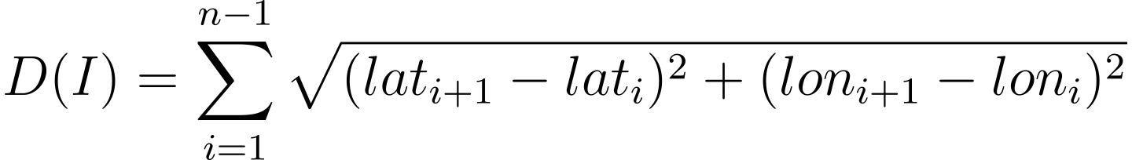
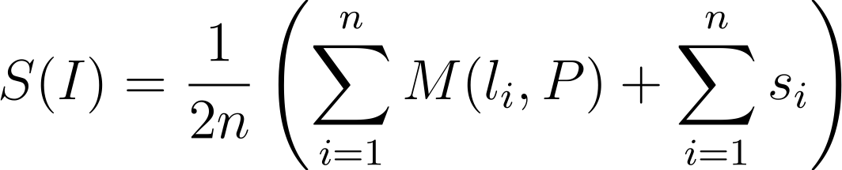
The NSGA-II Algorithm
Individual represented as a list of location ids, between 5 and 8 and created using the generate_individual() function.
Objective functions:
  Minimising Distance ->
  Maximising Satisfaction ->
Crossover: Order Crossover, 90%
Mutation: Custom add/remove/swap mutation, 20%
Parents Selection Mechanism: NSGA-II selection mechanism provided by the DEAP library in Python – selects parents that are non-dominated and are less crowded.
Notes:
Distance objective function -> Euclidean Distance
Satisfaction Objective function -> combines category match score and sentiment score:
n is the number of locations in the route.
M(lᵢ, P) is the category match score (1 if the location's category is in the user's preferred set P, 0 otherwise).
sᵢ is the sentiment score for location lᵢ.
The formula first adds the two scores together and then divides the result by 2n to get the final, combined average.

Slide 6
Experimental/Test Design
Ran two types of initial test:
  Unit testing
    Testing the three core functions from the last slide
  Algorithm Performance Testing

Slide 7
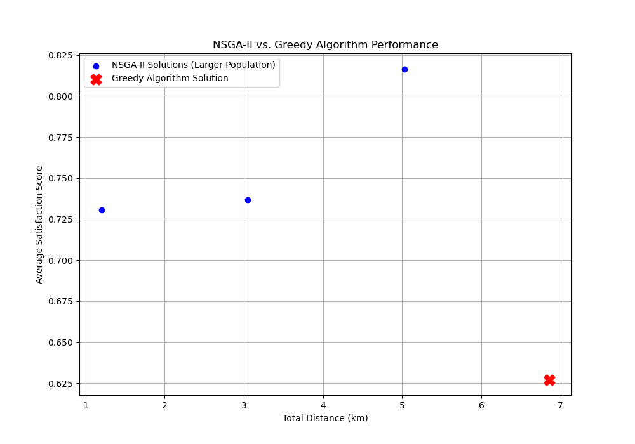
Results – NSGA-II vs Greedy

Slide 8
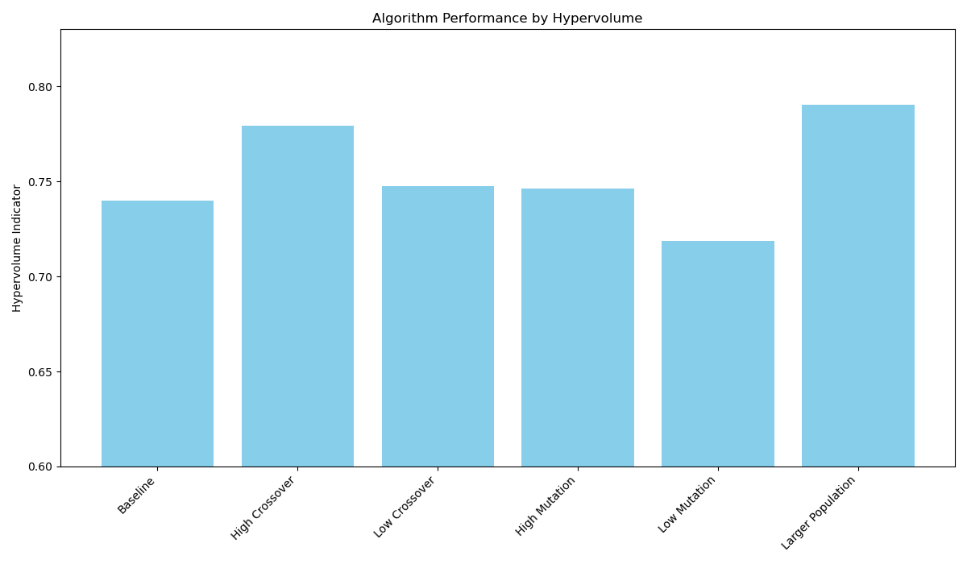
Results - Hypervolume

Slide 9
Future Work
Using real-time data via an API for X that uses exact location data and NLP to match tweets to locations in the database, to increase the interactivity of the tweet element of the app.
Integrate other forms of social media (with APIs) to turn TweetPath into a platform for users to directly reference and consult different social media recommendations for their travel planning.
Expand the locations database to over 500 locations in London, and perhaps in other cities and then evaluate the performance of the NSGA-II algorithm compared to other optimization algorithms.

